Slide 1
ITEC 3040 Group 3
Jordan Bayon
Jeremy Goldberg
Mars Leung
Sharmarke Salah-Mohamed
Isabelle Serufuli

Slide 2
Data Description
The Bank Marketing Dataset is related to direct marketing campaigns of a Portuguese banking institution.
The dataset consists of 11,163 observations with 17 features.
The features include age, job, marital status, education, housing loan, personal loan, contact type, month, day of the week, duration, campaign, and economic indicators such as emp.var.rate (employment variation rate), cons.price.idx (consumer price index), cons.conf.idx (consumer confidence index), euribor3m (Euribor 3 month rate), and nr.employed (number of employees).
The dataset can be used to optimize marketing strategies and predict whether a client will subscribe to a term deposit or not.
The data is related to phone call campaigns, and the classification goal is to predict if the client will subscribe to a term deposit.
The dataset provides an opportunity to identify the best strategies to implement for greater success in future campaigns.

Slide 3
Motivation
The Bank Marketing Dataset aims to optimize marketing strategies and predict term deposit subscriptions.
It allows exploration of the impact of call duration, month, and day of the week on marketing campaign success.
The project goal is to understand the relationship between call duration and term deposit subscription likelihood, investigate the influence of time variables, and compare classification algorithm performance.
The dataset aligns with the trend of leveraging data-driven approaches, like machine learning, to improve business performance, particularly in the finance industry.
By capturing and analyzing customer data, organizations can enhance customer experience and profitability.
The analysis aims to provide insights for future marketing campaigns and improve the efficiency of directed campaigns for long-term deposit subscriptions

Slide 4
Research/Application Questions
Effect of Duration on Subscription: Analyze the relationship between the duration of the call and the likelihood of a term deposit subscription.
Impact of Time Variables: Investigate the influence of the month and day of the week on the success of marketing campaigns.
Classification Algorithm Comparison: Evaluate the performance of various classification algorithms in predicting term deposit subscriptions.
Data Cleaning: We will have to do some data cleaning to this dataset to get rid of outliers. There are no missing values so we won’t have to replace these.

Slide 5
Exploratory Data Analysis
EDA involves delving into the distribution and relationships of the features, identifying trends, and understanding the impact of variables on marketing outcomes.
Visualizations like histograms, box plots, and scatter plots are used to gain insights into the distribution and relationships between variables.
Analyzing summary statistics, identifying outliers, and understanding the central tendencies and variability of the features can provide valuable insights.
The goal of EDA is to uncover patterns, understand the dataset's characteristics, and inform the selection of appropriate modeling techniques for predicting term deposit subscriptions.

Slide 6
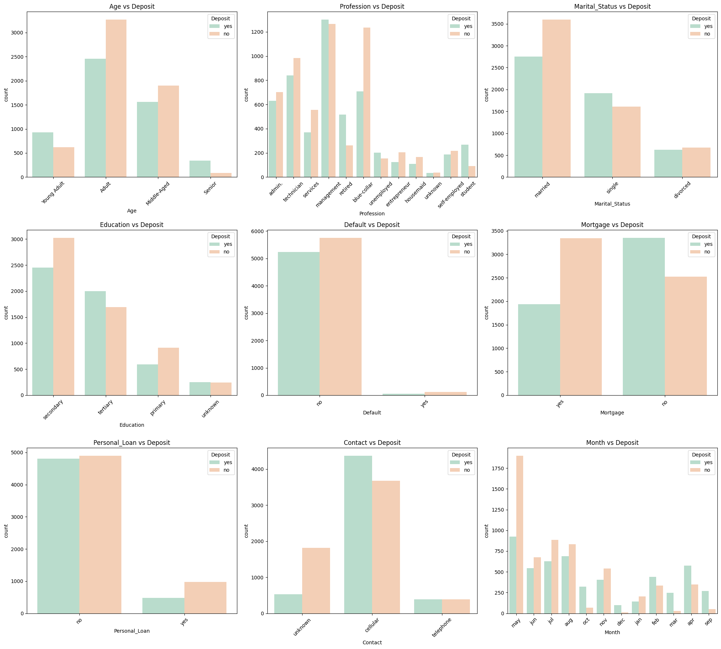
EDA
There was no missing data
There were no duplicate values
The majority of data for attribute poutcome was unknown so we removed the column.
Converted Age, from numeric to categorical.
Removed all the non-categorical columns as they are irrelevant to our question.
Renamed some attributes so they can be more comprehensible.
Suggest using Decision trees or Naive Bayes to predict likelihood of subscription based on the individual’s demographic attributes.

Slide 7
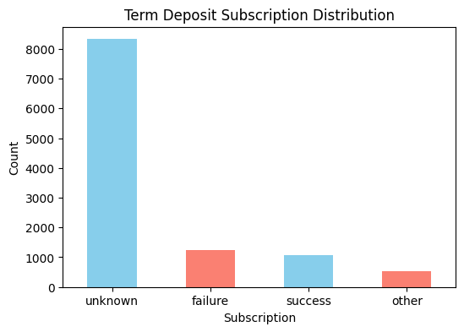
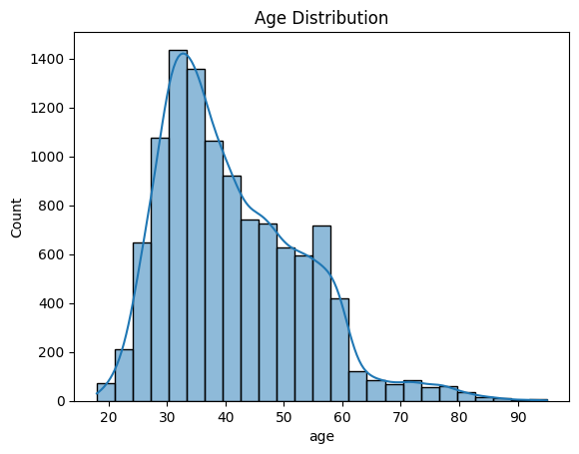
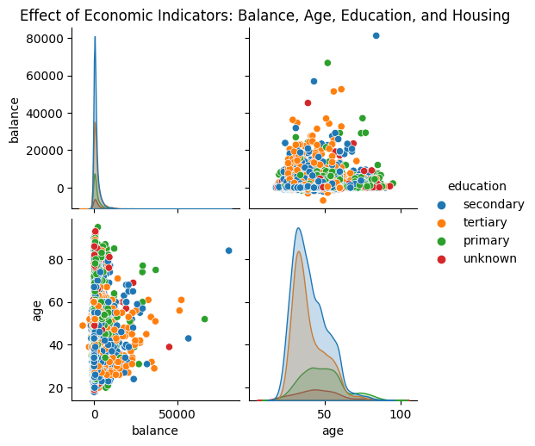
Exploratory Data Analysis

Slide 8
Techniques Used
The techniques used for analyzing the Bank Marketing Dataset include:
Data Preprocessing:
Label encoding was used to transform the target variable 'deposit' into numerical format.
Categorical variables were converted to numerical using one-hot encoding through the `pd.get_dummies` function.
Train-Test Split:
The dataset was split into training and testing sets using the `train_test_split` function from `sklearn.model_selection`.
Classification Algorithm Comparison:
The Random Forest Classifier from `sklearn.ensemble` was used to build a predictive model for term deposit subscriptions.
The model was trained on the training set and evaluated on the testing set using the `accuracy_score` metric from `sklearn.metrics`.
Outlier Detection and Handling:
Z-score method from `scipy.stats` was used to identify outliers in the 'duration' column.
Outliers were removed from the dataset based on the z-score threshold.
These techniques demonstrate the application of data preprocessing, train-test split, classification algorithm comparison, and outlier detection and handling to gain insights into customer behavior and optimize marketing strategies in the finance industry

Slide 9
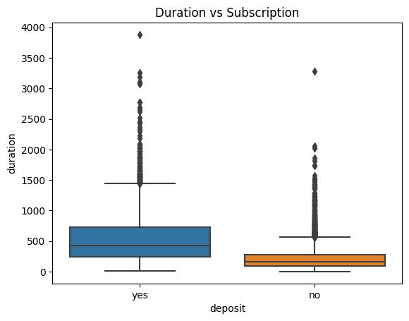
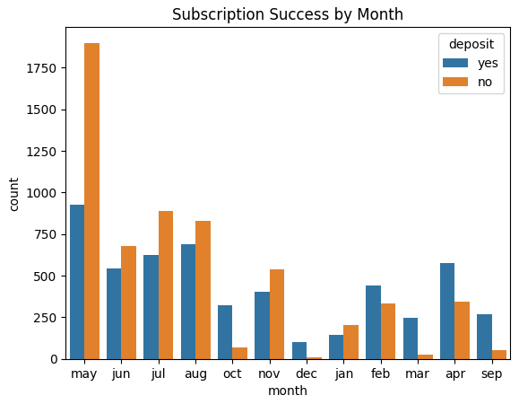
Results
After our code preprocessed the data and split it into training and testing sets, a Random Forest Classifier was trained on the training data and used to predict the target variable on the testing data.
The results indicated that the Random Forest Classifier achieved an accuracy of approximately 83.56% in predicting term deposit subscriptions.
Looking at graphs below, we can see that the months of October, December, February, and September all had much higher success than failures
The month of May had the highest total responses with around twice as many failures than successes
The duration was also much longer for people that chose to deposit versus those who didn’t
Using this knowledge, banks can deduce which months will have the highest campaign success rates and which users to focus on for longer subscription durations

Slide 10
Discussion

